Slide 1
Machine Learning INET Fall 2024

Slide 2
Agenda
Training:
Pre-training
Fine tuning/ Alignment/ Domain Adaptation
Transformer Architecture
T5
GPT
Decoding Mechanisms

Slide 3
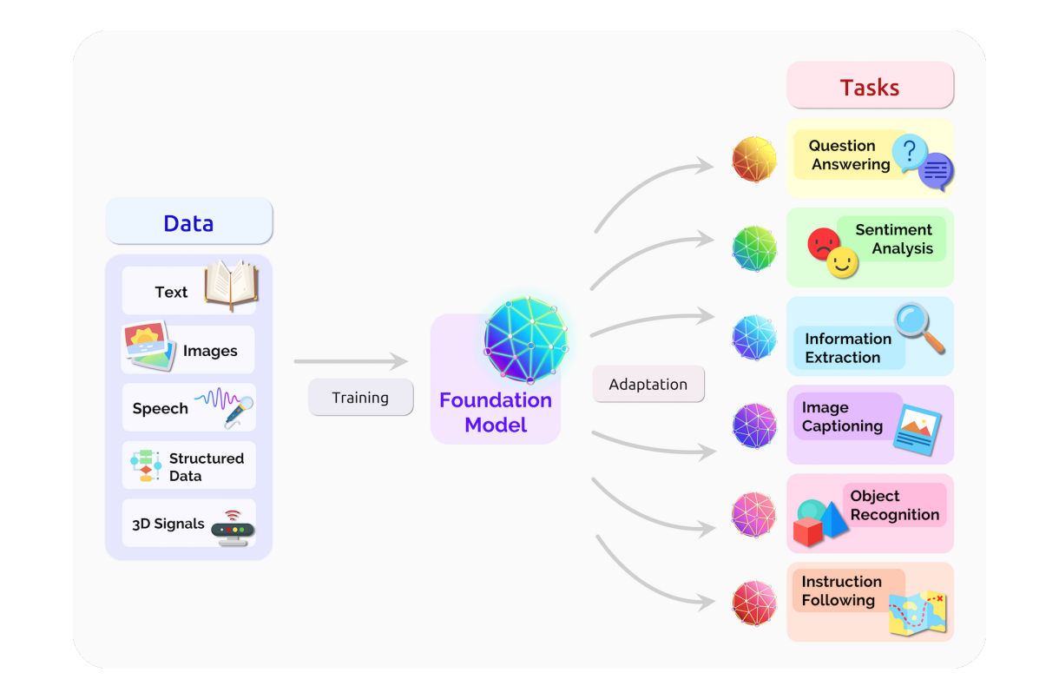
Training: Pre-Training vs Alignment

Slide 4
Transformers
Transformers are building block of NLP today. They come as either
Encoder: BERT, RoBERTa
Decoder: GPT, Transformer-XL
Encoder-Decoder: T5, BART

Slide 5
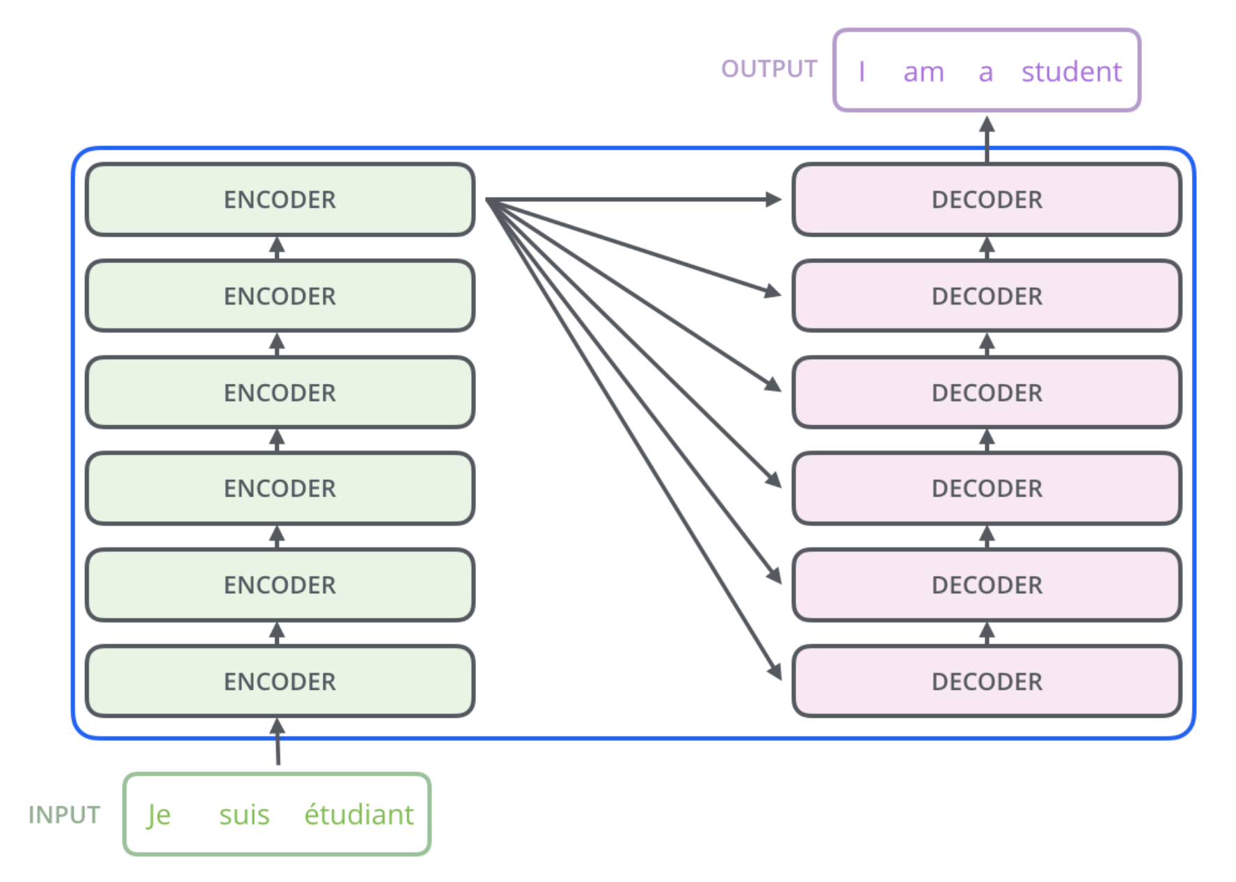
Transformers

Slide 6
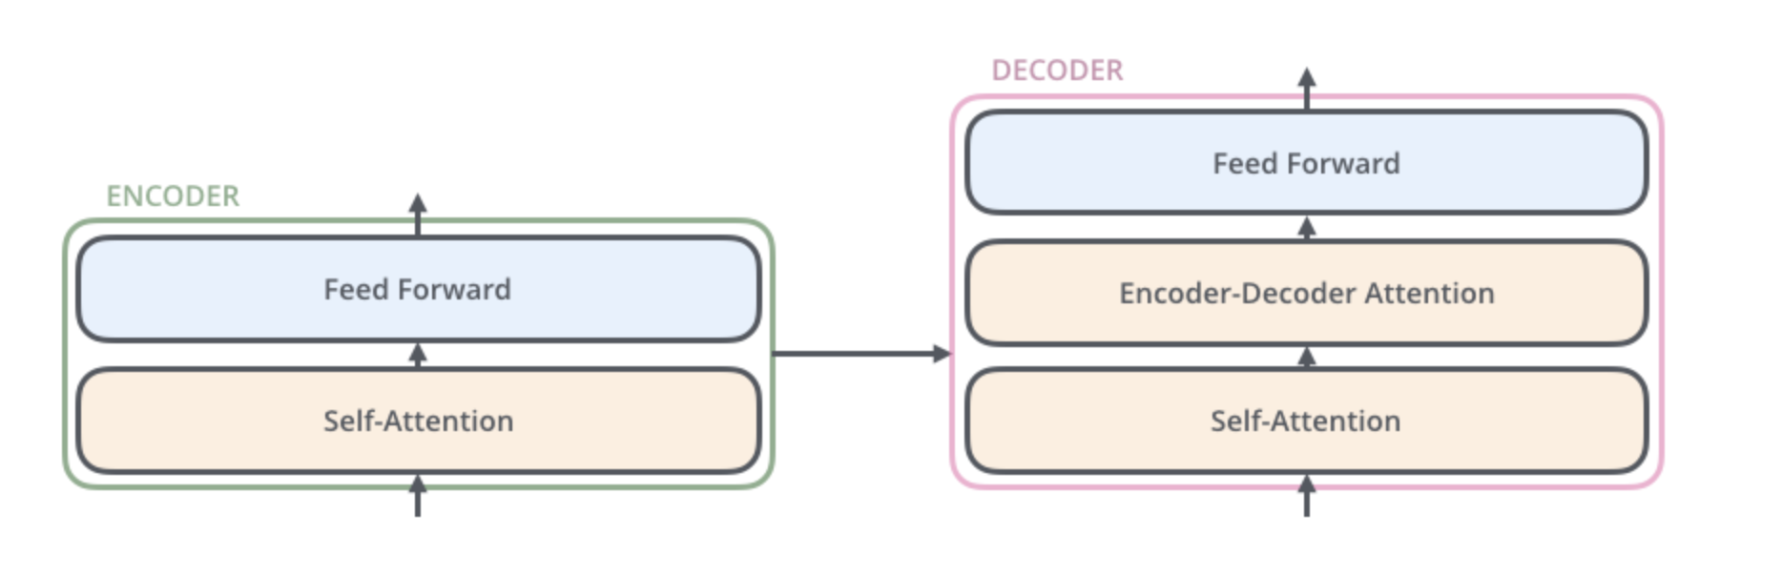
Transformers

Slide 7
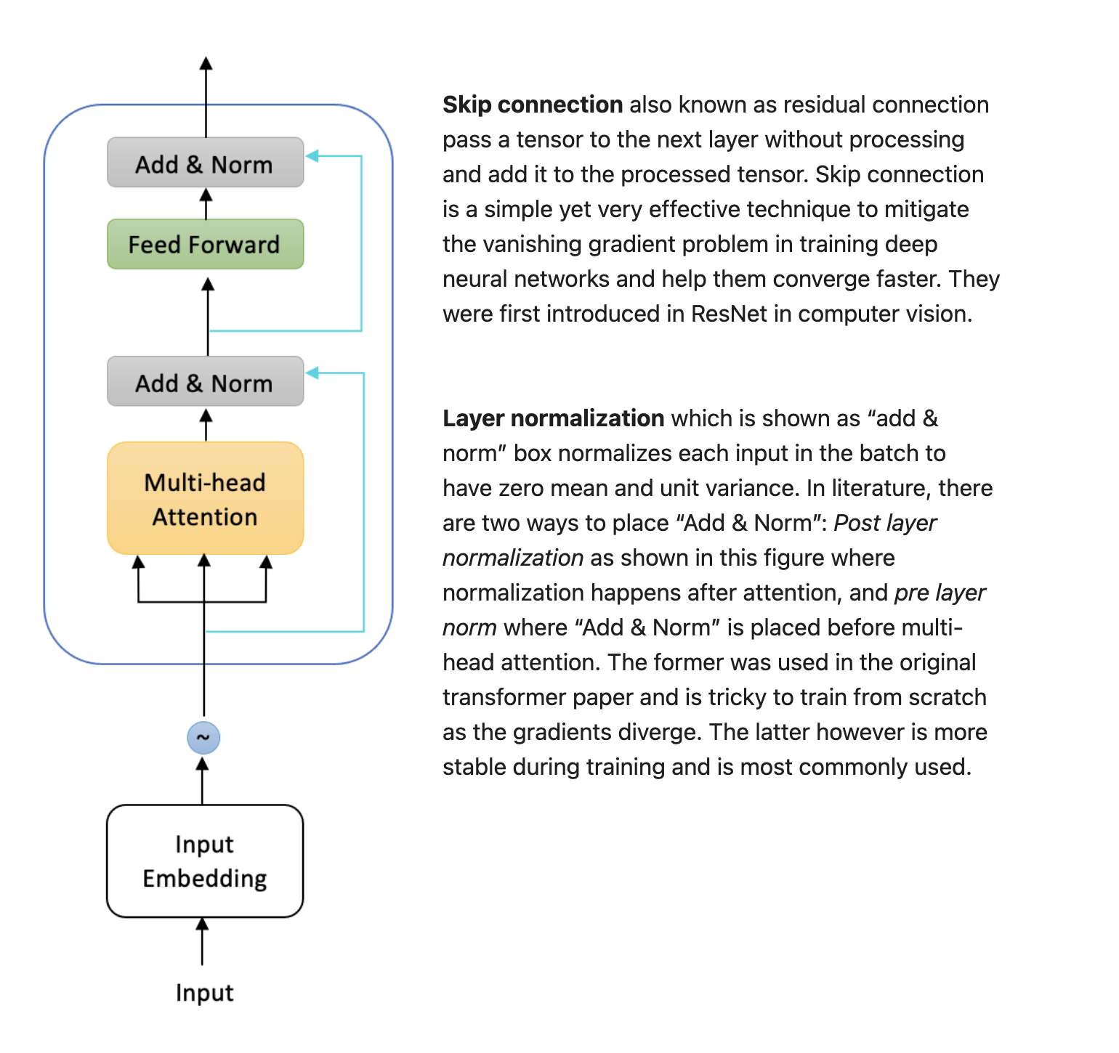
Encoder – zoom in

Slide 8
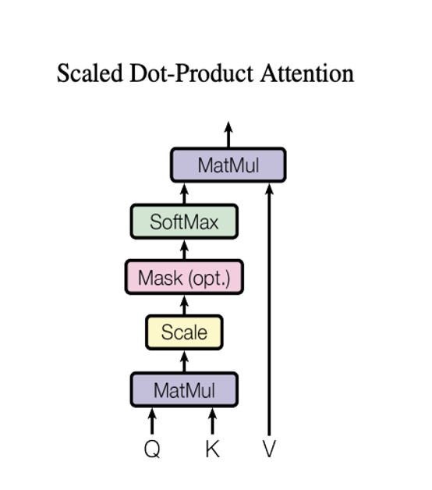
Self Attention Head
Each attention head is a mechanism that assign a different amount of weight or “attention” to each element in the sequence.
It does so by updating each token embedding as weighted average of all token embeddings in the sequence. Embeddings that are generated in this way are called contextualized embeddings.
The weights in the weighted average are called attention weights.
There are several ways to implement a self-attention layer; the most common method is scaled dot-product attention.

Slide 9
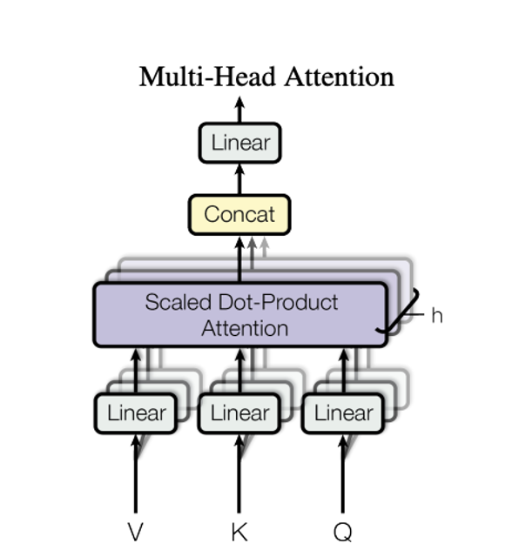
Multi-head attention
The multi-head attention consists of
multiple attention heads.

Slide 10
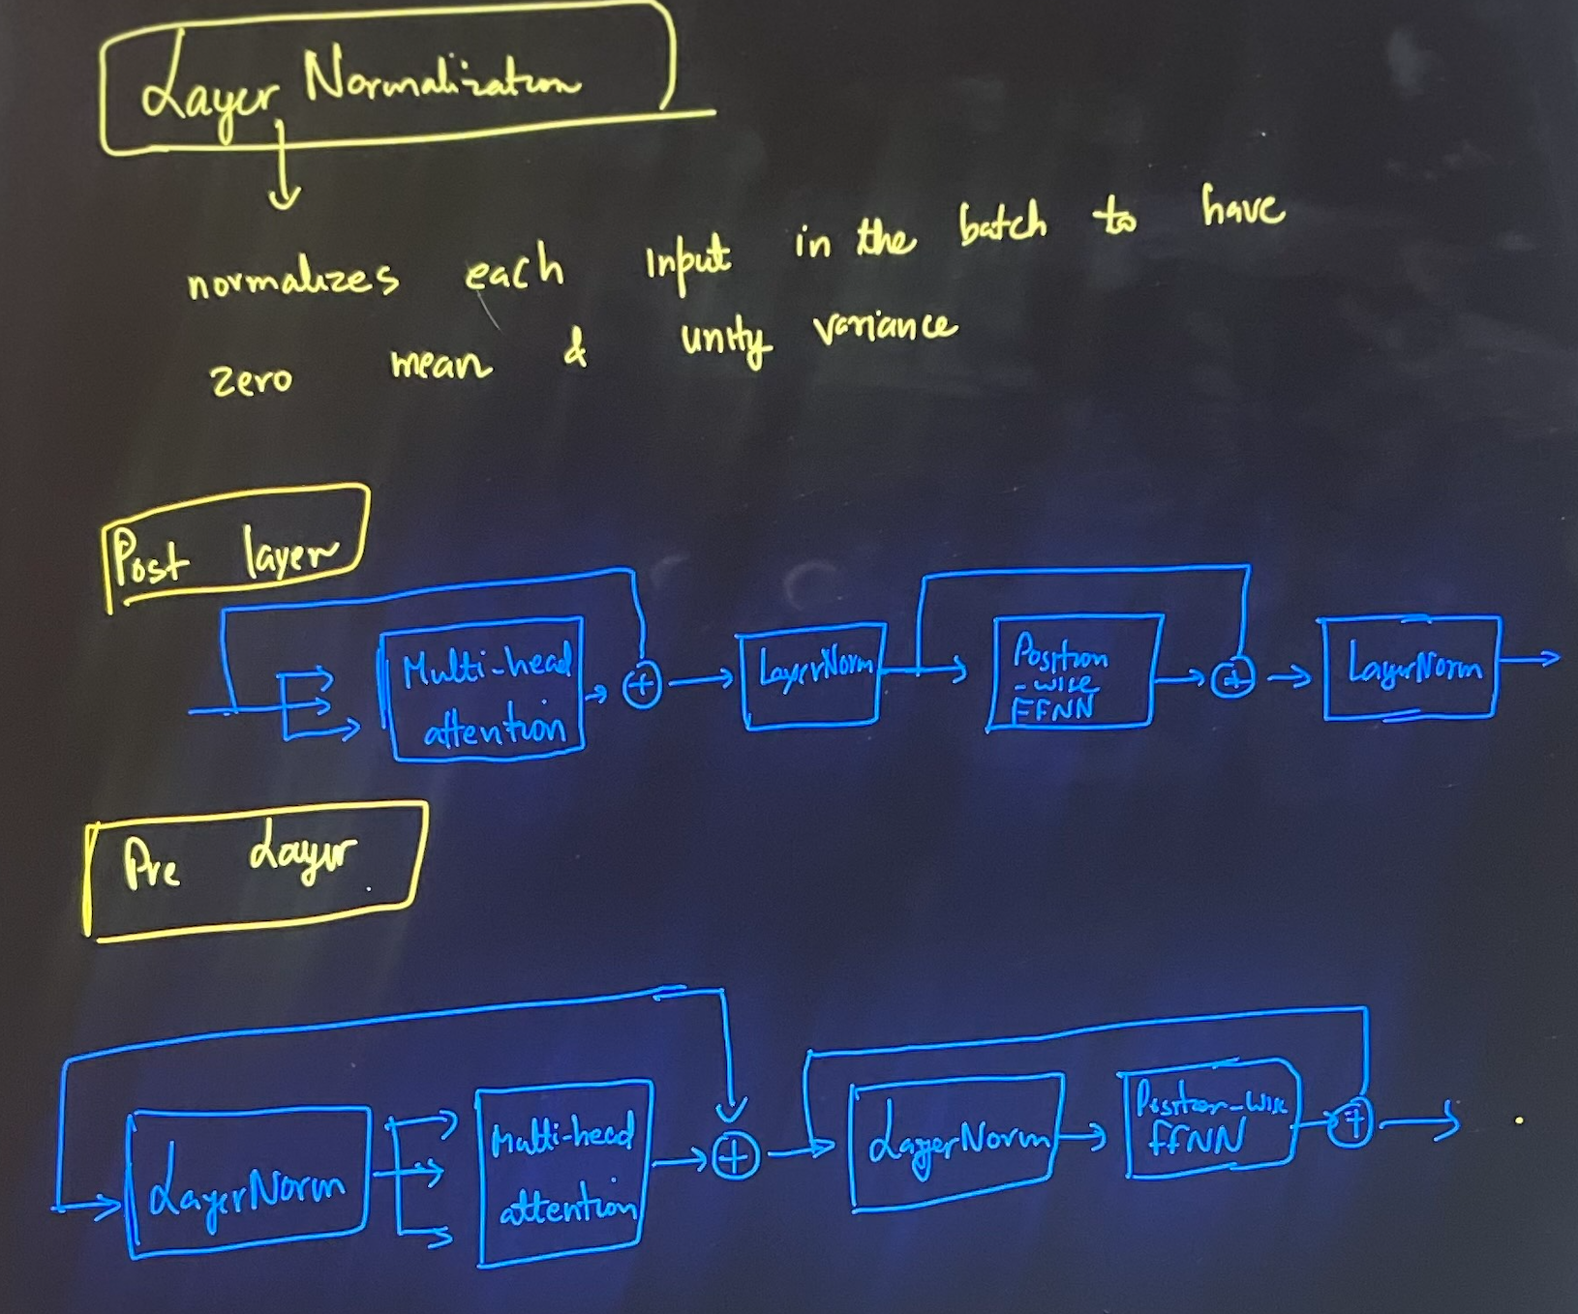
Layer normalization normalizes across the feature dimension, thus enjoying benefits of scale independence and batch size independence.
Batch normalization is usually empirically less effective than layer normalization in NLP tasks, where the inputs are often variable-length sequences.
Notes:
Post-layer normalization was in transformer paper. It is tricky to train from scratch as gradients can diverge. For this reason you will often see a concept known as learning rate warm-up.
Pre-layer normalization is most common arrangement. This tend to be much more stable during training and does not require any learning rate warm up.

Slide 11
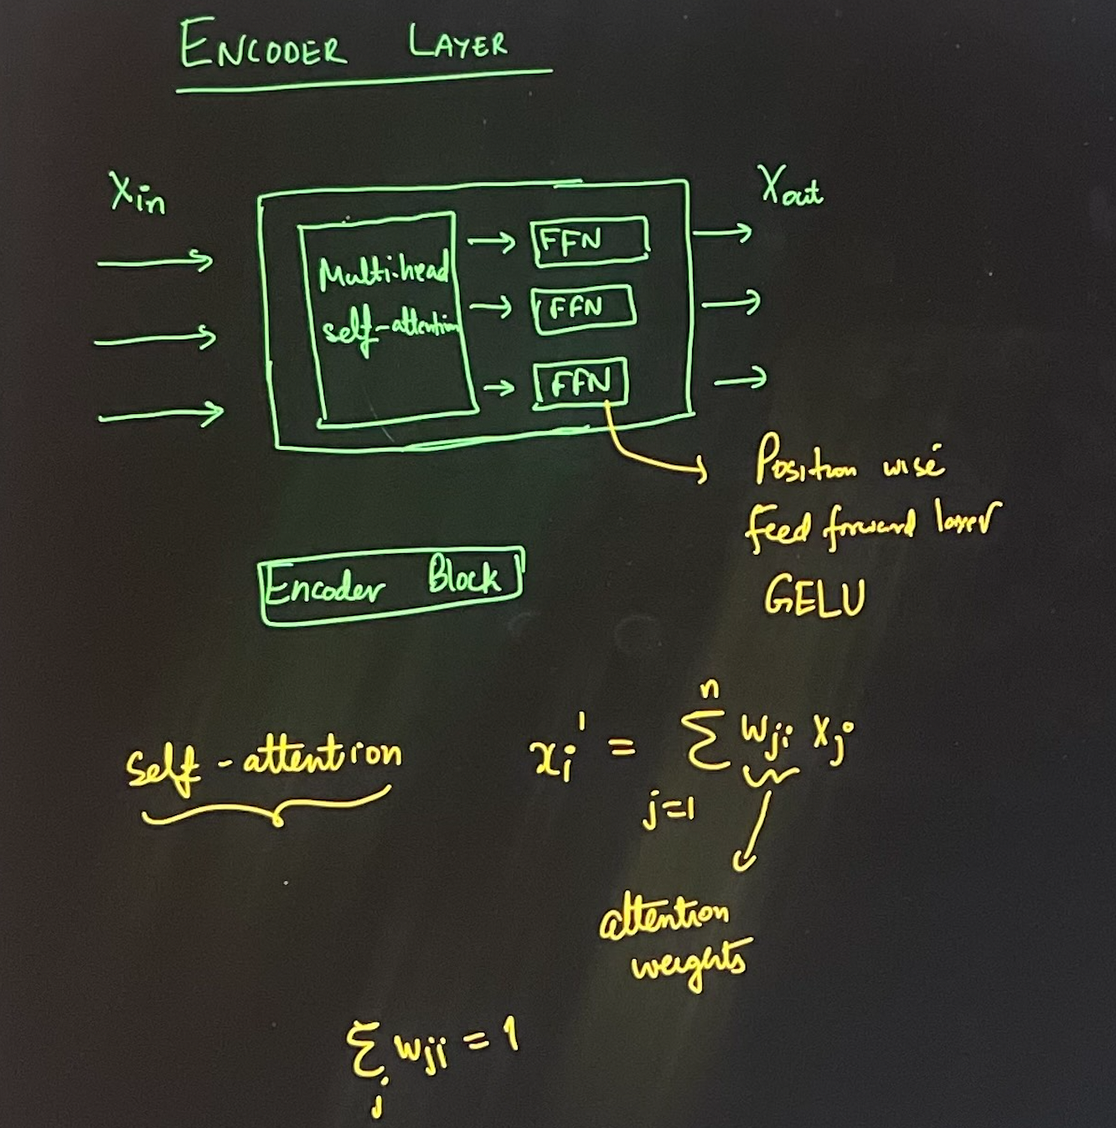
Encoder Layer - Closer Look

Slide 12
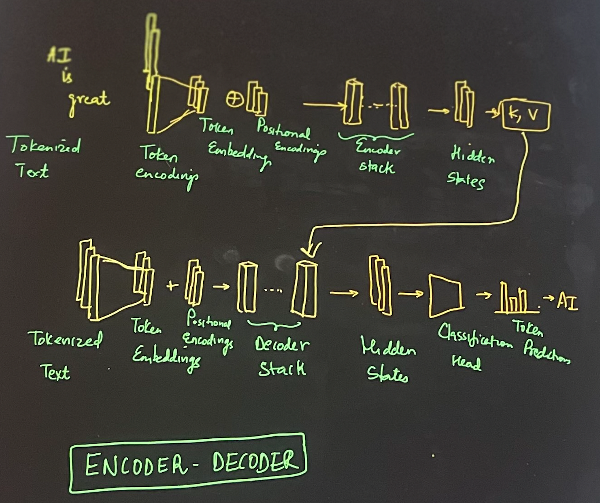
Transformers - For the nth time!

Slide 13
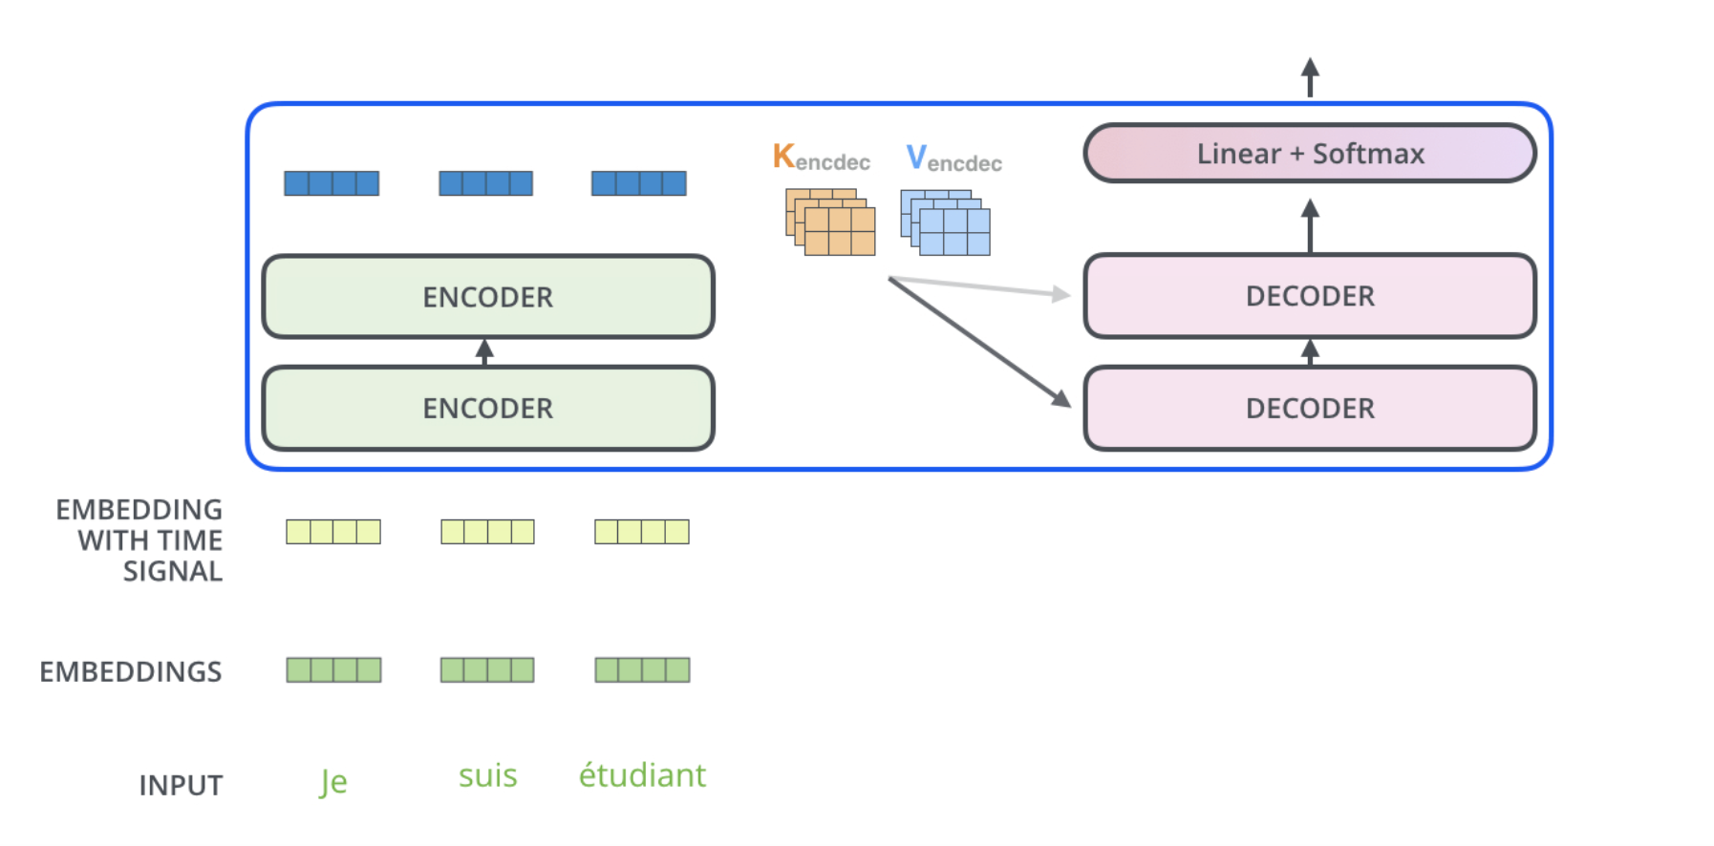
Decoder Block
Notes:
The encoder start by processing the input sequence. The output of the top encoder is then transformed into a set of attention vectors K and V. These are to be used by each decoder in its “encoder-decoder attention” layer which helps the decoder focus on appropriate places in the input sequence:

Slide 14
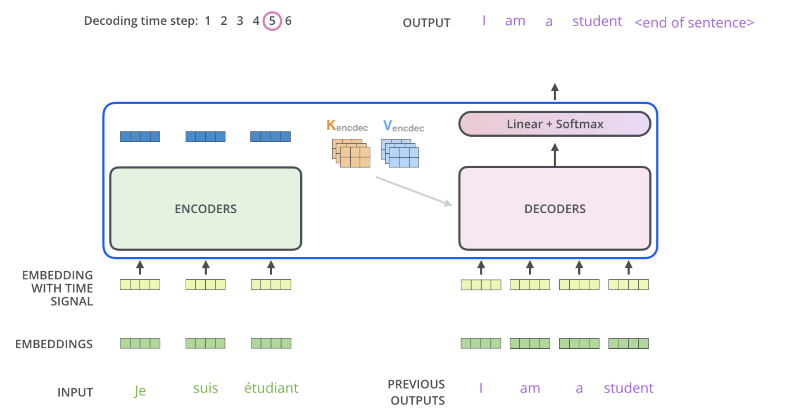
Decoder Block
Notes:
The following steps repeat the process until a special symbol is reached indicating the transformer decoder has completed its output. The output of each step is fed to the bottom decoder in the next time step, and the decoders bubble up their decoding results just like the encoders did. And just like we did with the encoder inputs, we embed and add positional encoding to those decoder inputs to indicate the position of each word.

Slide 15
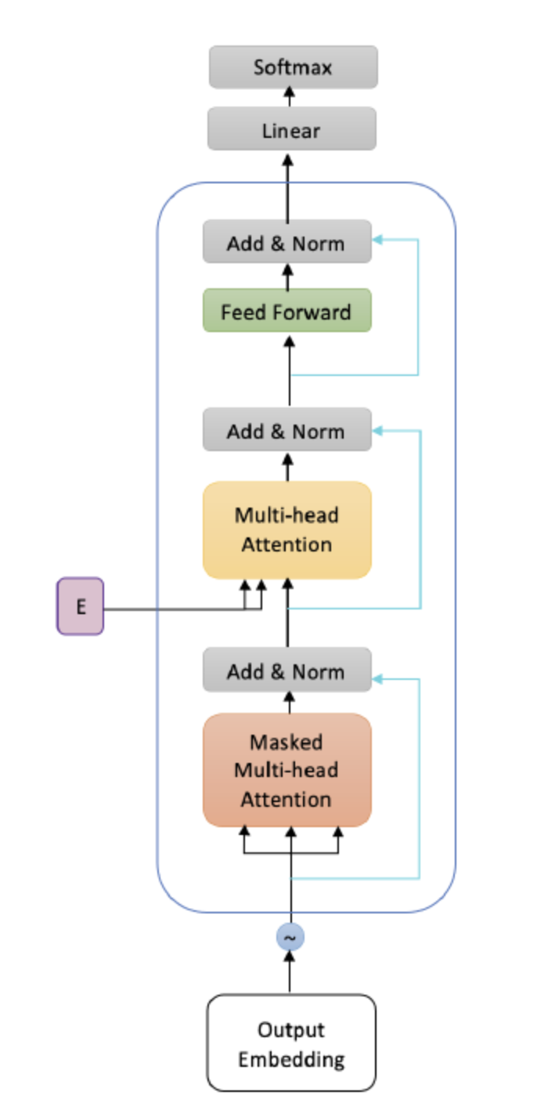
Decoder Block
The decoder’s job is to generate text sequences.
Every decoder layer has:
two multi-headed attention sub-layers,
a pointwise feed-forward layer,
residual connections,
layer normalization.
The decoder block is capped off with a linear layer that acts as a classifier, and a softmax to get the word probabilities.
The decoder is autoregressive, it begins with a start token, and it takes in a list of previous outputs as inputs, as well as the encoder outputs that contain the attention information from the input.

Slide 16
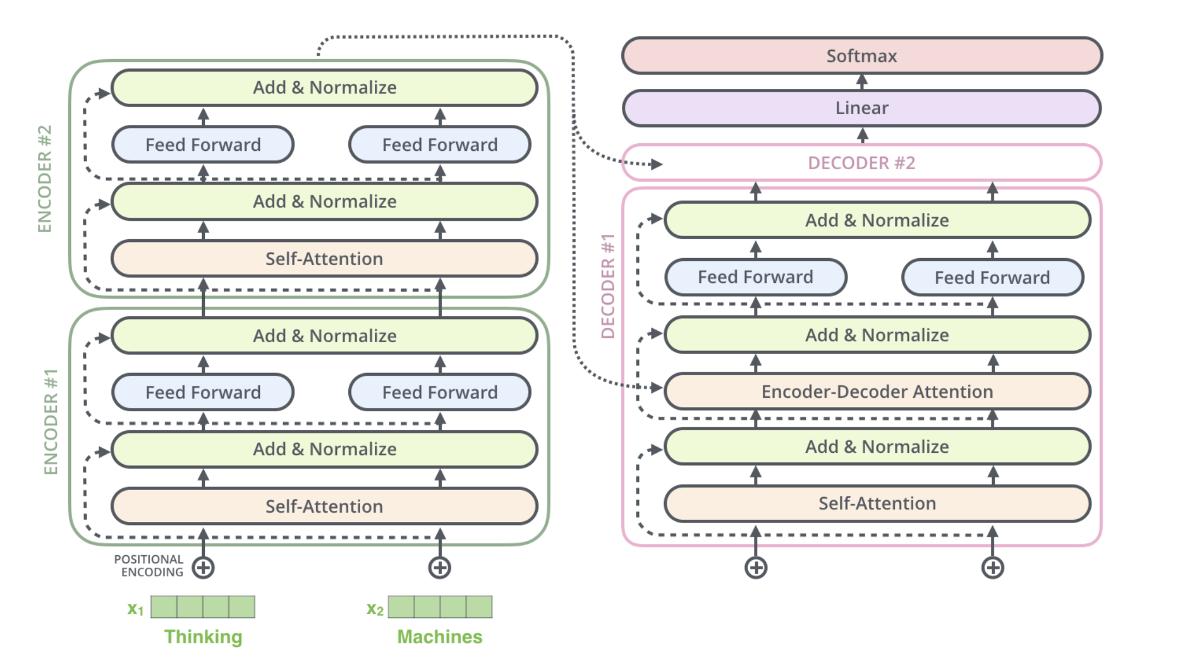
Decoder Block

Slide 17
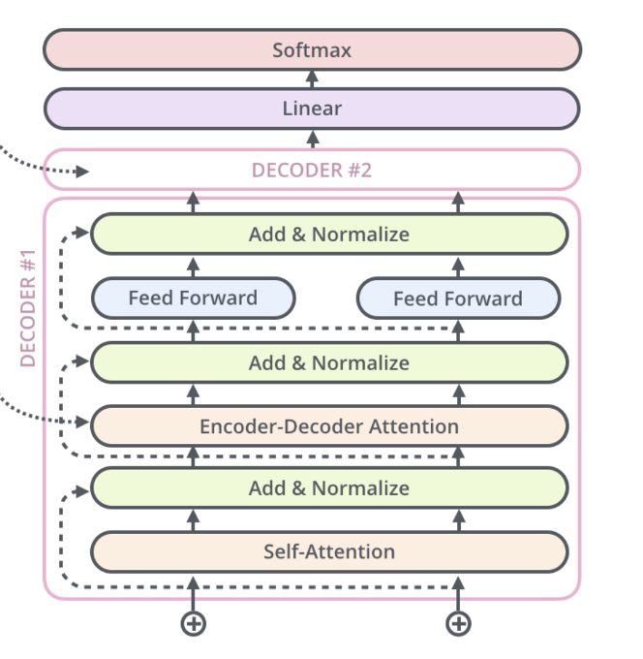
Decoder Block
The decoder has two attention sublayers:
Masked multi-head self attention layer: ensuring tokens we generate at each step are only based on the past outputs and the current token.
Encoder-decoder attention layer: outputs of last encoder act as key, value and the intermediate representation of the decoder act as queries.

Slide 18
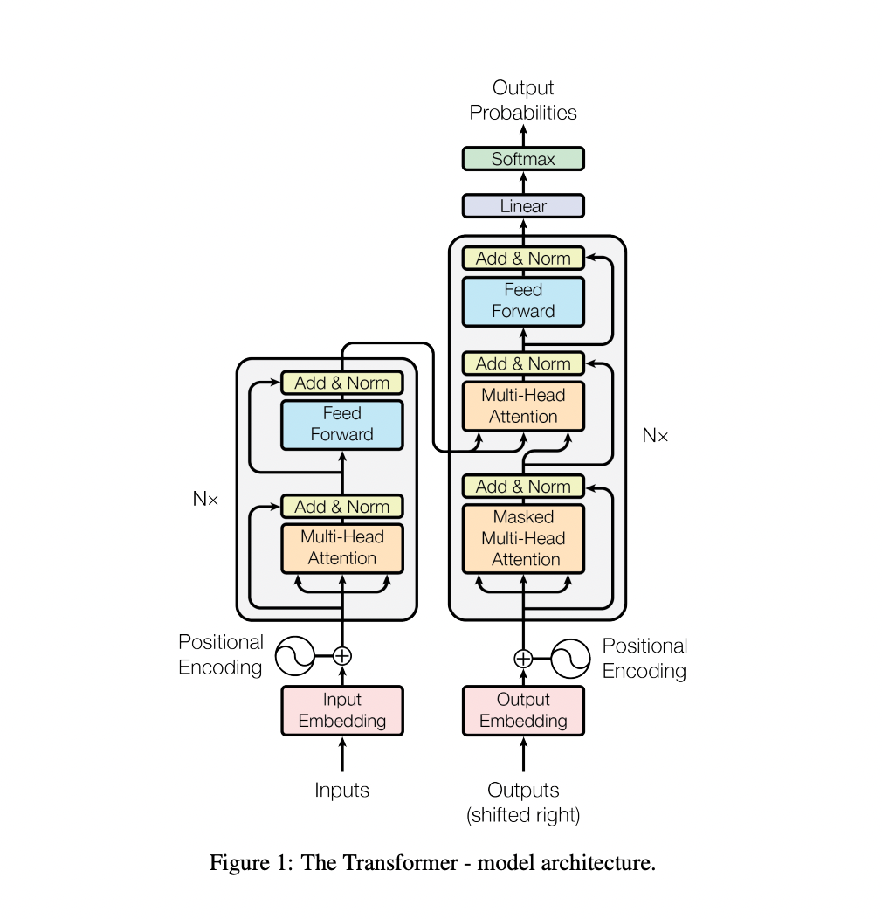
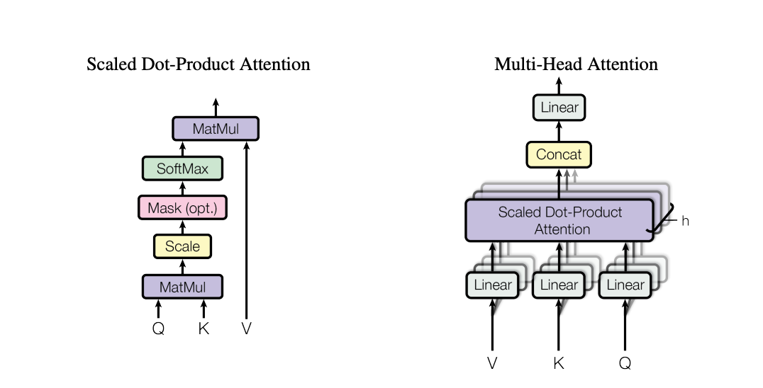
Illustrations from Attention is all you need (Vaswani et al)

Slide 19
Why did the LLMs take the world by storm?

Slide 20
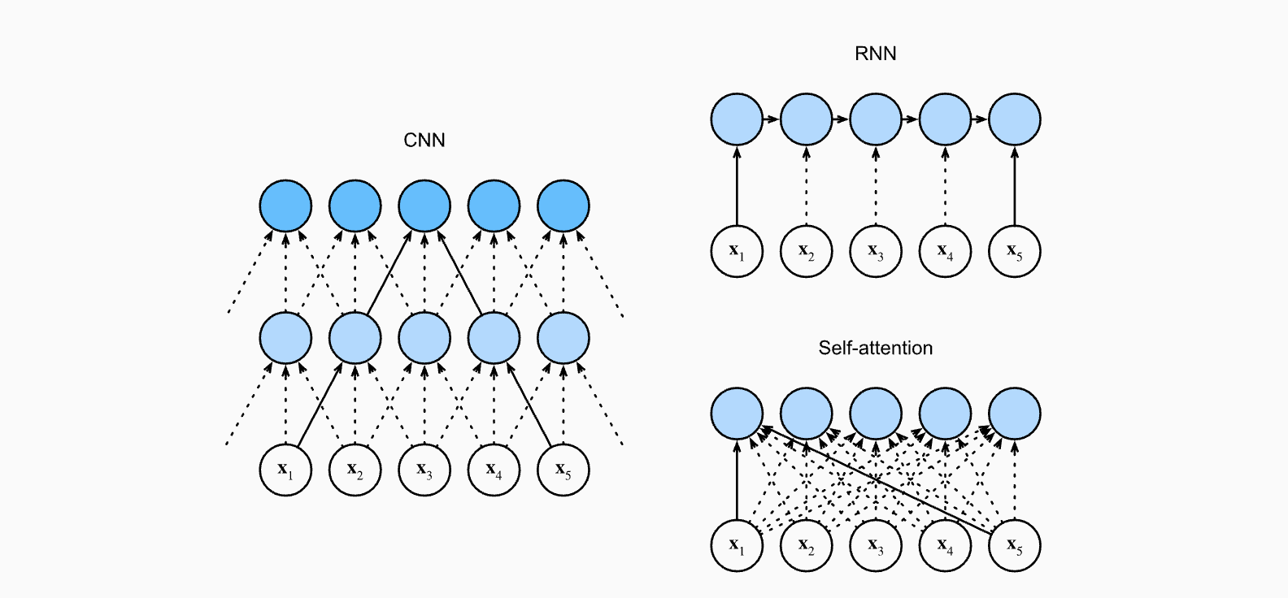


computational complexity, sequential operations, and maximum path lengths if we are mapping a sequence of length n to length n ?
dimensional of the hidden state - d
Transformers —> not sequential and can be parallelized, maximum path length O(1), computational complexity
RNNs —> Sequential with length O(n), computational complexity

Slide 21
Pre-training using self-supervision
Training encoder - decoder models needs <source, target> pairs
Example - Neural Machine Translation, Spelling Correction, Summarization, Q&A
But gathering human labels is hard. To learn semantic relationships on internet-scale data, human labeling quickly becomes infeasible
Solution - ?
BERT !! - Introduced MLM (Masked Language Model) paradigm
Notes:
Why are these topics important?

Slide 22
T5 and Multi-Task Learning

Slide 23
T5
Text to Text Transfer Transformer = T5
A encoder-decoder architecture
Use MTL during pre-training stage
A unified framework that converts all language problems into text-to-text format
Taking text as input and producing text as output
Examples: translation, question answering , summarization, sentiment classification
This allows to use same model, hyperparameters, loss function across all tasks
To specify which task the model should perform, they add a task-specific (text) prefix to the original input sequence before feeding it to the model.
Notes:
Represent everything as a sequence
And to make it multi-task: in front of each task add a prefix to describe the task. The task prefix is placed in front of input.
Input Representation
The input sequence is packed together with a task descriptor string into one contiguous sequence.
For example, the task could be "translate English to French" and the input is the English sentence.
Pre-training Objective
15% of the time, randomly mask out some tokens from the input sequence.
The model is trained to reconstruct the masked out tokens, similar to BERT's masked language modeling.
Denoising Objective
For the rest 85% of instances, corrupt the input by applying noise functions like token deletion, insertion etc stochastically.
Train the model to reconstruct the original, uncorrupted input.
Encoder-Decoder Modeling
The encoder takes the corrupted sequence as input and generates encoder representations.
The decoder attends to these representations to reconstruct the original input sequence from the perturbations.

Slide 24
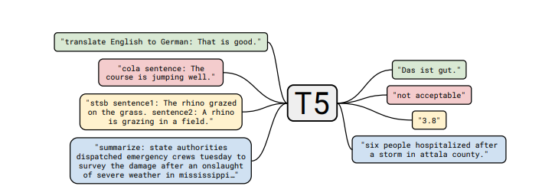
T5
Multitask Learning but with a trick → using task prefixes!
Notes:
Represent everything as a sequence
And to make it multi-task: in front of each task add a prefix to describe the task. The task prefix is placed in front of input.
COLA refers to the Corpus of Linguistic Acceptability, a dataset consisting of English sentences labeled as either grammatically acceptable or unacceptable.
STSB stands for Semantic Textual Similarity Benchmark. It is a dataset consisting of sentence pairs and human ratings on their semantic similarity.

Slide 25
T5
T5 casts all NLP tasks into a text-to-text format with an input text sequence and target text sequence.
It uses a standard Transformer encoder-decoder architecture to map the input text to the target text.
The loss function used for training is the usual maximum likelihood estimation (MLE) loss. This measures the cross-entropy between the model's predicted token probabilities and the ground truth target tokens.
This same text-to-text format and MLE loss function is used for all tasks - classification, question answering, summarization, translation etc.
The only difference between tasks is a task-specific prefix added to the input sequence to indicate the desired task.
Notes:
Represent everything as a sequence
And to make it multi-task: in front of each task add a prefix to describe the task. The task prefix is placed in front of input.

Slide 26
GPT = Generative Pre-training

Slide 27
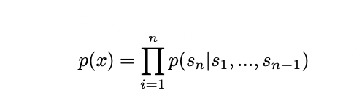
GPT & GPT-2
Generative Pre-training
Trained to predict the next word in a sequence, given all previous words. This trains it to generate fluent streams of text.
Unidirectional: Processes text only from left to right order.
Self-supervised: Pretrained on massive diverse unlabeled corpora.

Slide 28
Challenges with generative models and some solutions
Decoding (response) is probabilistic and hence can be unhinged (meaningless / low quality, toxic, false, hallucination etc.) → Chain of Thought prompting, RLHF, DPO, RLAIF
Longer context (prompt) → Takes longer to compute (why?)
What if we need domain adaptation? → Supervised Fine-tuning, Instruction Fine-tuning
Deploying in production is a major issue due to model size, attention is quadratic in sequence length → Distillation, Specific kernels, Runtimes, Hardware, Flash Attention, Hyper Attention

Slide 29
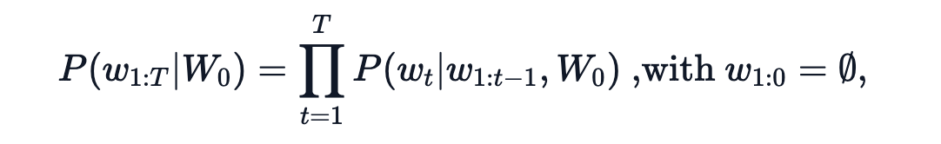
Decoding Mechanisms
Greedy Search - Emit the most likely token at every time step
Beam Search - Keep the most likely num_beams of hypotheses at each time step and eventually choosing the hypothesis that has the overall highest probability

Slide 30
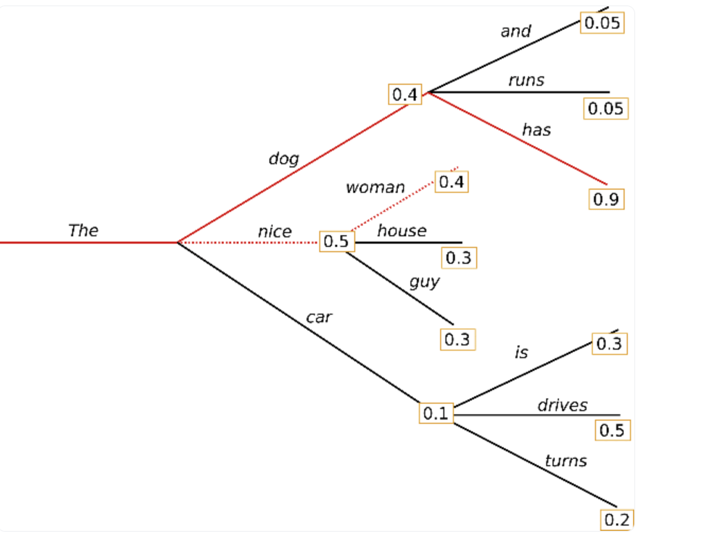
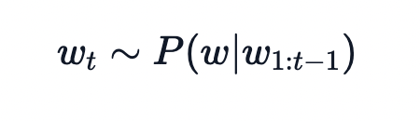
Greedy would emit nice first, followed by house
Beam Search - dog, has
Sampling based - Randomly pick the next word from the conditional probability distribution
This will lead to probabilistic responses (not fixed anymore!)

Slide 31
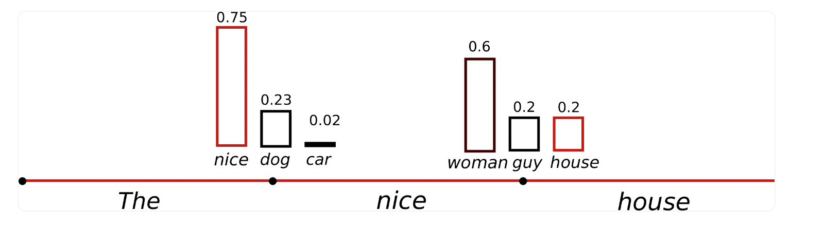
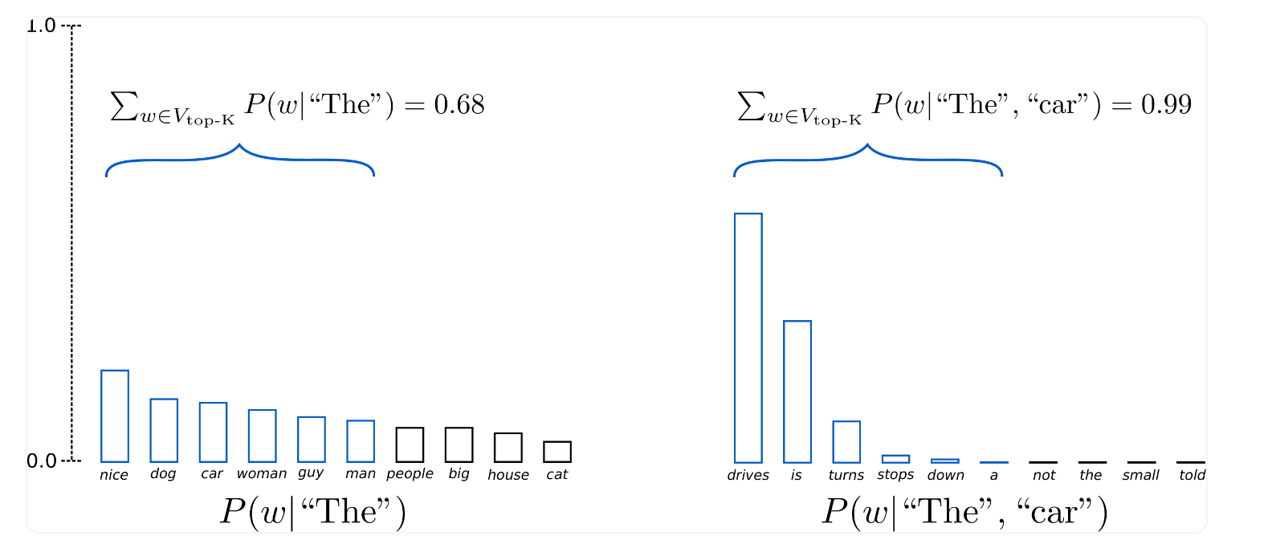
Top-K sampling - K most likely next words are filtered and the probability mass is redistributed among only those K next words. Then sample! GPT-2 used this and was successful in story generation tasks.

Slide 32
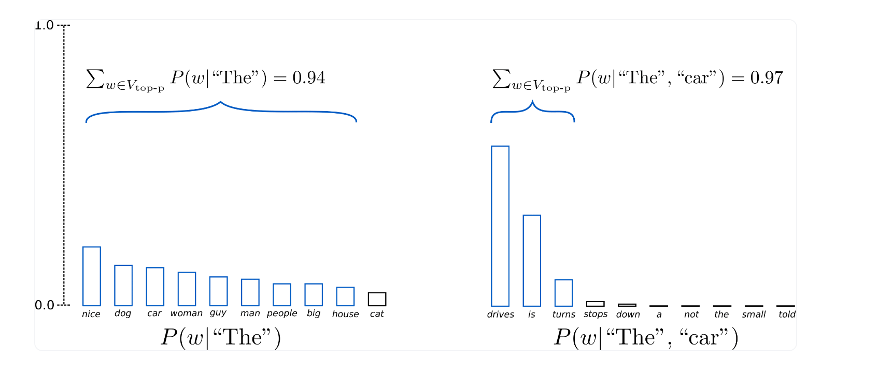
Nucleus Sampling - Choose from the smallest possible set of words whose cumulative probability exceeds the probability p

Slide 33
Summary
Transformer Architecture
Encoder / Decoder / Encoder-Decoder
GPT and Decoding Mechanism
T5

